Slide 1
three.js Solar System
By: Alberto Young
CAP 4720

Slide 2
Project Description
3D Model of the solar system:
Built entirely using the three.js library
Components included:
Various Geometries (Sphere, Ring)
Texture Mapping
Adjustable Camera
Custom Shader Texture

Slide 3
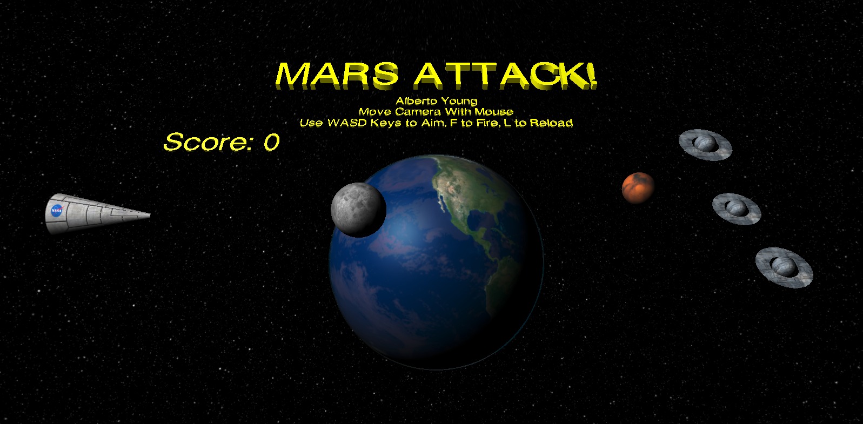
Beginning
Angry Birds Game:
Created an Earth, Moon, and Mars Model to create space-themed Angry Birds game.

Slide 4
Changes
Used Angry Birds as a platform to start building a full solar system model.
Changes:
Added 9 planets, Moon & Sun.
Set different orbit speeds for each planet.
Changed planet sizes to be scale accurate.
Added custom shader texture to the sun to give it an animated look, as well as a glow texture.
Switchable camera angles that follow each planet.

Slide 5
Solar System Demo
Launch Demo

Slide 6
Future Goals
Use Ray casting to allow user to click on a planet to focus on it.
Make planet distances and orbit speed accurate.
Add camera zooming animations
Add all planet moons.
Milky Way model???

